Slide 1
Universal Design For Learning (UDL)
Dr Lisa Padden, University College Dublin
28th October 2022

Slide 2
My Work – University for All
Design for All
Weaves inclusion into fabric
Moving from margins to mainstream
Everyone’s business – embedded/integrated
All students feel welcome, belong, valued

Slide 3
What is Universal Design?
Universal Design is the creation of a product/service/environment which can be accessed, understood and used to the greatest extent possible by all people regardless of their age, size, ability or disability

Slide 4
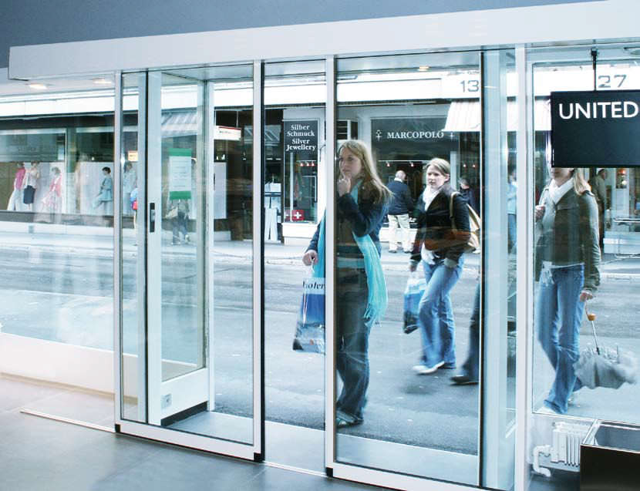
Universal Design (UD) in Action
Notes:
Recognises that nobody is average so if you design for the average, you design for nobody – design to the edges and you design for everybody.

Slide 5
Why Universal Design for learning?

Slide 6
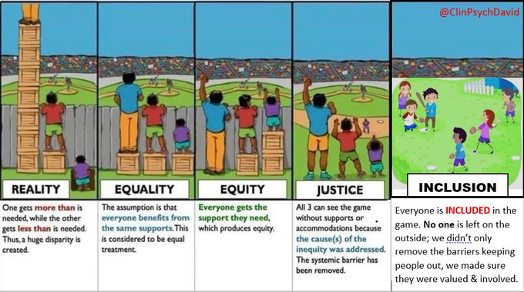
Why UDL?
Creating a fully inclusive educational experience – access, participation, success
Remove barriers and increase opportunities through flexibility
Learner Variability – most diversity is ‘hidden’
Proactive rather than reactive
Image from the David Murphy, Plymouth University

Slide 7
Universal Design - Removing Barriers
Moving on from a deficit model
We must adapt to be inclusive of all students – rather than expecting the student to change in order to fit in.

Slide 8
What are the barriers?

Slide 9
Comparing Differentiation and UDL
Differentiation and Add-on Supports:
Reactive – Putting up ladders
UDL:
Proactive – Smashing down walls

Slide 10
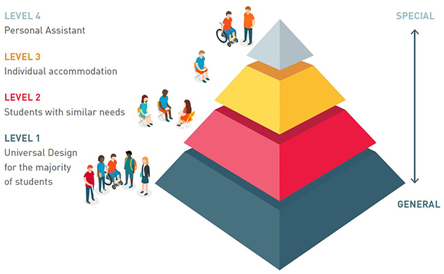
Multiple layers of inclusion in The UDL Pyramid
Level 4: PA
Level 3: individual accommodation
Level 2: students with similar needs
Level1: UDL for the majority of students
AHEAD, 2017 UDL continuum of supports

Slide 11
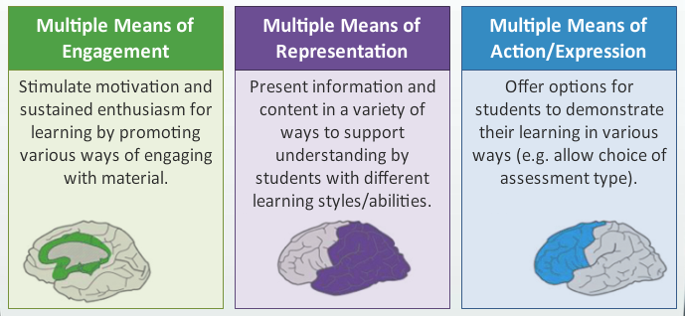
Universal Design for Learning
Rose & Meyer 2014

Slide 12
Why UDL?
Evidence-based, Quality
Internationally recognised
Policy - aligned
Successfully implemented at all levels of education
Non prescriptive – your UDL for your learners

Slide 13
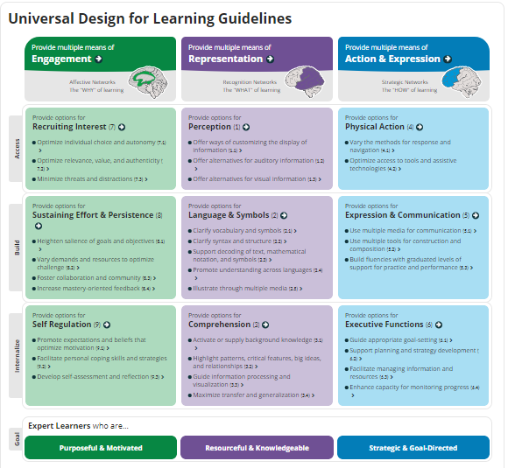
CAST.org
UDL Guidelines and Checkpoints

Slide 14
+1 Approach to UDL
As we progress through this session think about the small changes you will make
Thomas Tobin’s +1 approach to UDL advocates for small changes which together have a significant impact on the experience of learners

Slide 15
Provide options for Engagement
Why?
Recruit interest by giving students some choice and autonomy
Encourage students to persist and sustain effort by providing clear goals and objectives linked with assessment – look for opportunities on your LMS or VLE to do this
Foster collaboration with and between students
Develop ways for students to self-assess and reflect on their learning
Demonstrate the authenticity of assessment strategies as well as what and how the student is learning
Goal: To Develop Purposeful and Motivated Students

Slide 16
Engagement: student voice
Build bridges: reach out make it interesting and welcoming
Be personal, share your experience, it is relationships that matter
Be authentic and consistent
Speak a language we understand
Communication on platforms we use
Expect us to succeed
Make it fun to contribute
Research by AHEAD.ie

Slide 17
Provide options for Representation
Consider which platform you use and how you use it
flexible teaching methods with a choice of activities
Use of clear language and clarify new vocabulary and symbols
Use alternative ways to present knowledge – technology, multimedia, visuals, charts
Create or encourage students to create mind maps, models and other creative learning materials
Provide accessible digital materials including your slides for all students
Provide glossaries and FAQs
Use authentic ‘real life’ learning examples.
What?
Goal: To Develop Knowledgeable and Resourceful Students

Slide 18
AHEAD AT Hive
Tools, devices, applications or features of applications that can support people with disabilities to learn and work more effectively and meet the challenges posed by the impact of their disability or the inaccessible design of environments and materials.
Screen reading software that supports visually impaired people to navigate computers,
Speech to text software which turns voice into written text.
mainstream mobile solutions – apps on smartphones and tablet devices which can support everything from personal navigation (map apps), organisation (calendar/scheduling apps) and memory aids (to do apps).
AHEAD AT Hive – Resources and Matching Tool

Slide 19
Accessible Content Checklist
Sans-serif font
Slides - minimum font 24, print - font 12
Avoid underlining, italics and BLOCK CAPITALS
Alternative text on images, tables and graphs
Good colour contrast
Left align your text
Heading styles
Microsoft accessibility checker!
Meaningful URL links
Edited captions on videos
Live captioning and Reasonable Accommodations for events
Notes:
These are habits which participants can start today! Many of these accessibility elements are picked up by the Microsoft Accessibility checker which is under the “review” tab. Over time they will all become second nature!

Slide 20
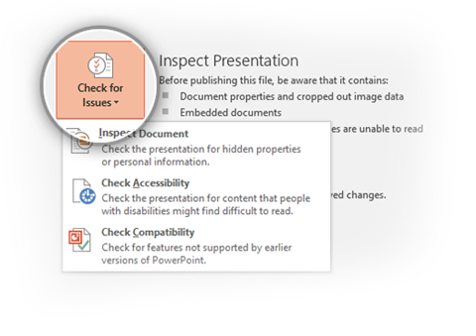
Microsoft Accessibility Checker
The Accessibility Checker should pass without errors.
To run the Accessibility Checker, go to
File >
Check for Issues >
Check Accessibility

Slide 21
Accessibility
Alternative Text
A description of an image, diagram, table or graph for screen-reader users.
Alt text will also appear in MP3s and HTML where an image cannot load.
Context is key!
Colour Contrast
Distinction between light levels of two colours i.e. Text vs background.
Maximum contrast is black/white.
For graphs it can be helpful to print in grey scale to get a true feel for contrast.
Check contrast using WebAim.
Headings
Important for structuring a document – both on a visual and behind the scenes level (metadata).
Set document headings using the Home tab on Word – don’t rely just on bold / underline!
Headings should follow a clear hierarchical flow ie. Title,1,2,3,4.

Slide 22
Creating Accessible PDF documents
PDF files are usually created in another programme and converted to PDF.
Content, such as heading levels, lists, and alternative text for images is exported.
Use the Export feature to save documents as PDF.
Be careful not to print to PDF!

Slide 23
Plain English - readability
Check the whole document
It's simple, clear and concise
The topic is obvious
The main message is obvious
It's obvious what action the reader needs to take
Check the document structure
Detailed, explanatory document title or page headline
Summary or key message follows title or headline
Content organised in a logical sequence for the reader
Each paragraph starts with its topic
Short paragraphs
Sub-headlines and short lists break up solid text

Slide 24
Provide options for Action & Expression
Model Assistive Technology use e.g. Text to Speech Software
Build in reflective practice for students – provide templates
Clarity of goals for assignments/assessments
Use of a broad range of assessment types through diversity and choice of assessment
Provide support to gain skills needed for assessment types – essays, presentations, posters etc.
Give constructive, timely feedback
Embed self assessment: checklists and reflections
How?
Goal: To Develop Strategic and Goal-Directed Students

Slide 25
Inclusive Assessment and Feedback
Transparent
Scaffolded
Choice of assessment
Variety of assessment
Authentic assessment
Student self monitor/self assess
Students peer assess/review
Programme approach
Supportive policies
Staff development

Slide 26
UDL Badge
National Forum for the Enhancement of Teaching & Learning in Higher Education
Digital Badge in Universal Design for Teaching & Learning
Over 2000 recipients so far in the sector
National and Local roll outs

Slide 27
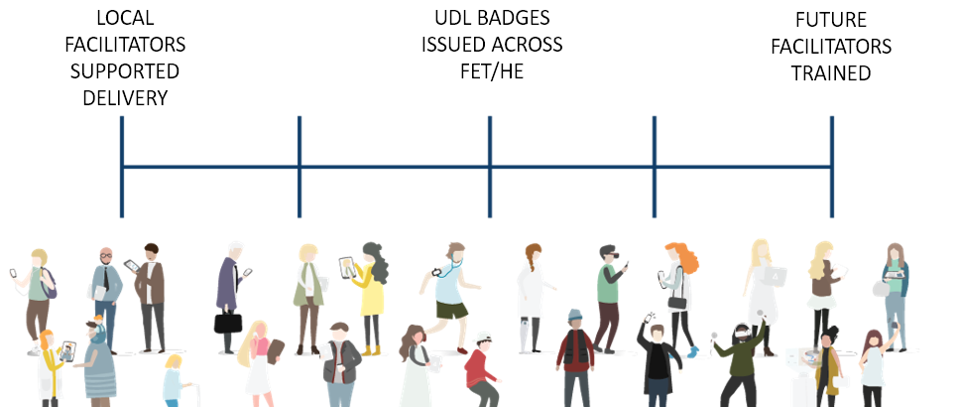
UDL BADGE 2021 OUTCOMES
86
43%
771
138

Slide 28
UDL BADGE 2021 IMPACT
“The programme has shown me how, with small changes, across my practice, I can support a more inclusive and engaging educational experience, respecting the individuality of each participant.”
“It completely changed my perspective, I’m more critical of my instruction now”
“I will question structures and processes more. Introduce more choice for students. Encourage a more collaborative approach with students”

Slide 29
www.ucd.ie/universityforall

Slide 30
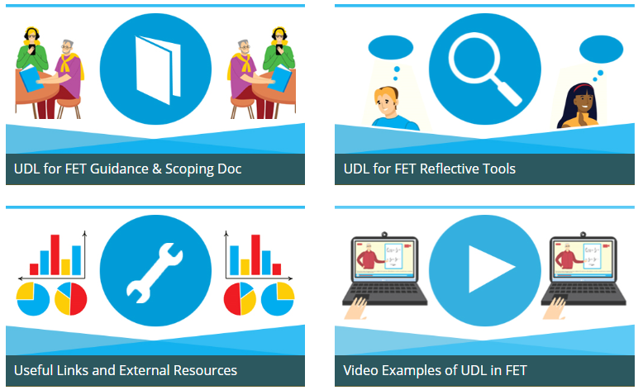
UDL for FET Resource Hub
www.ahead.ie/udlforfet

Slide 31
Thank you
lisa.padden@ucd.ie

